Slide 1
Booting from hard disk…
Starting Windos 2…
Press here to boot

Slide 2



Slide 4
Memphis the virtual assistant is coming soon!
All apps
Computer
Run
Find ALPHA
Sign out
Power off
Windos 2.0
Click me to exit start menu

Slide 6
Intranet explorer
NO INTERNET
TAP HERE TO CONNECT TO THE INTRANET

Slide 7
Email 1.00
No intranet!
Fix it here

Slide 8
Browser 0.09
This browser is in alpha!
Wait until a later update to use it in beta/full version!
About: alpha
No Intranet

Slide 9
Find ALPHA
File to find:
Windos. exe
Look in:
All drives
This is an alpha program.
You might not get anything!
Search now

Slide 10
C:\
Cannot view folder for some unknown reason.
Please check in the next update

Slide 11

Computer
C:\

Slide 12





All apps
Power menu
browser
email
antivirus+
Intranet explorer

Slide 14
inetwiz.exe
Connecting to the intranet
Please wait…

Slide 15
Find ALPHA result
Found:
C:\windos\system32\windos.exe
The file is 0.0001Mb in size and was created on : 23/04/2020
Open the file
exit

Slide 16
windos.exe
You cannot tun 2 instances of Windos at once, silly!
ok

Slide 17
Run
Enter the name of the program you wish to run, and Windos will run it for you:
Windos.exe
Run
Cancel

Slide 18

Power menu
Power off
restart

Slide 19
login
username
********
>

Slide 20
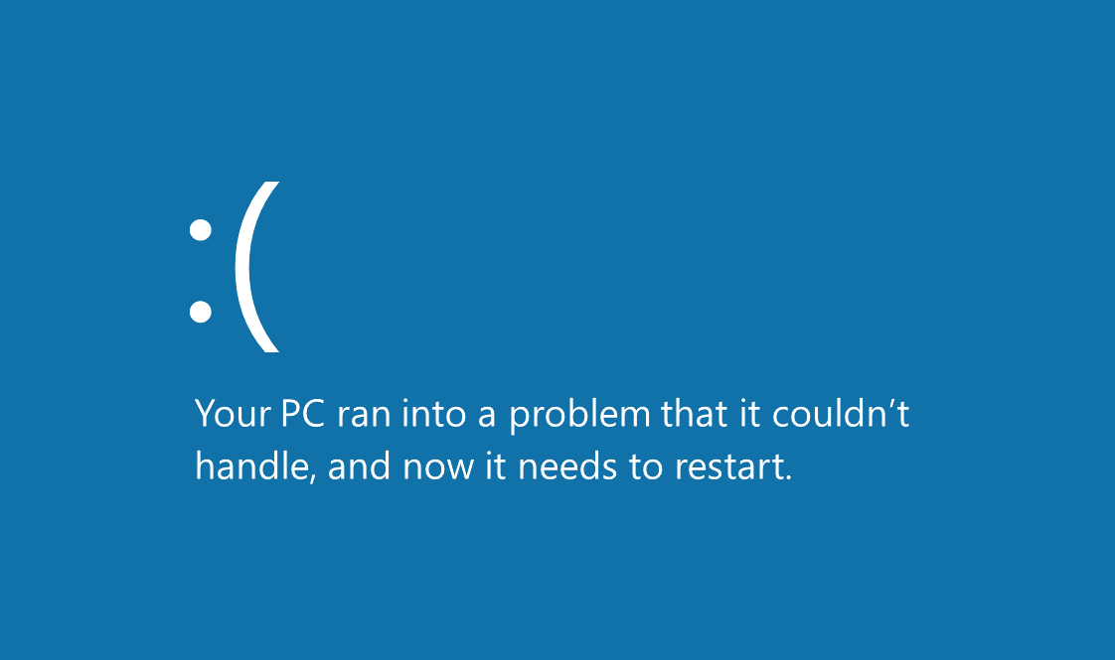

Slide 21


Windos 2
beta 1
For testing purposes ONLY
What’s new:
Now in beta!
Added shortcuts to start menu
Added email
All shortcuts should work now
Announce: icons are back!
Added Clippy click thing…
Added antivirus+
Added Intranet explorer
Added inetwiz.exe
Added trash-can
Hint of the version:
Click me for a random website! Internet needed!
Trash-can
start

